Slide 1
Diksha SUNDARAM FINTECH-2025
Team Members
Abhishek KUMAR
Albin Benny
Anil rasa
Ancha Navyasri
Lokesh batta
Praveen R
Vikram

Slide 2

Introduction
Home insurance is a service that protects your house and belongings from damage or loss due to events like fire, theft, natural disasters, or accidents. If something bad happens, the insurance company helps you pay for the repairs or replacements.
Different Types of Home Insurance Polices
Policy issuance
Premium calculation
Claim processing
Customer Support

Slide 3
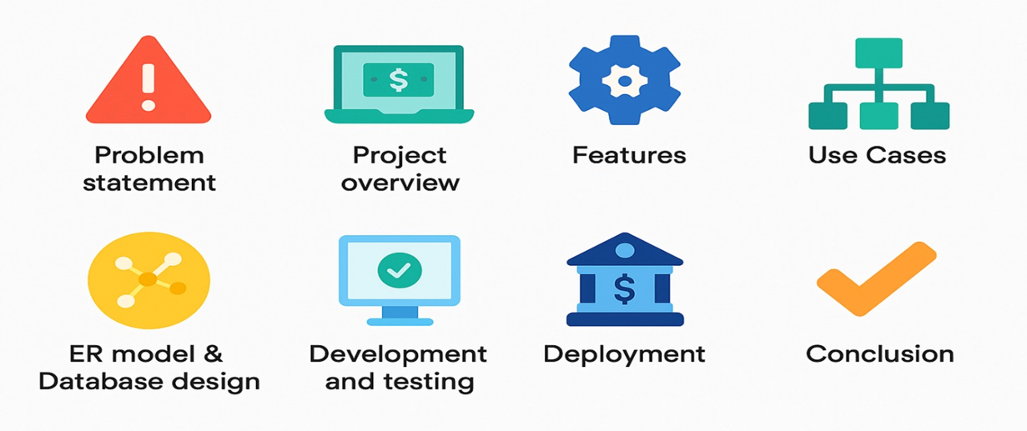
aGENDA

Slide 4




Welcome to Home Page

Slide 5
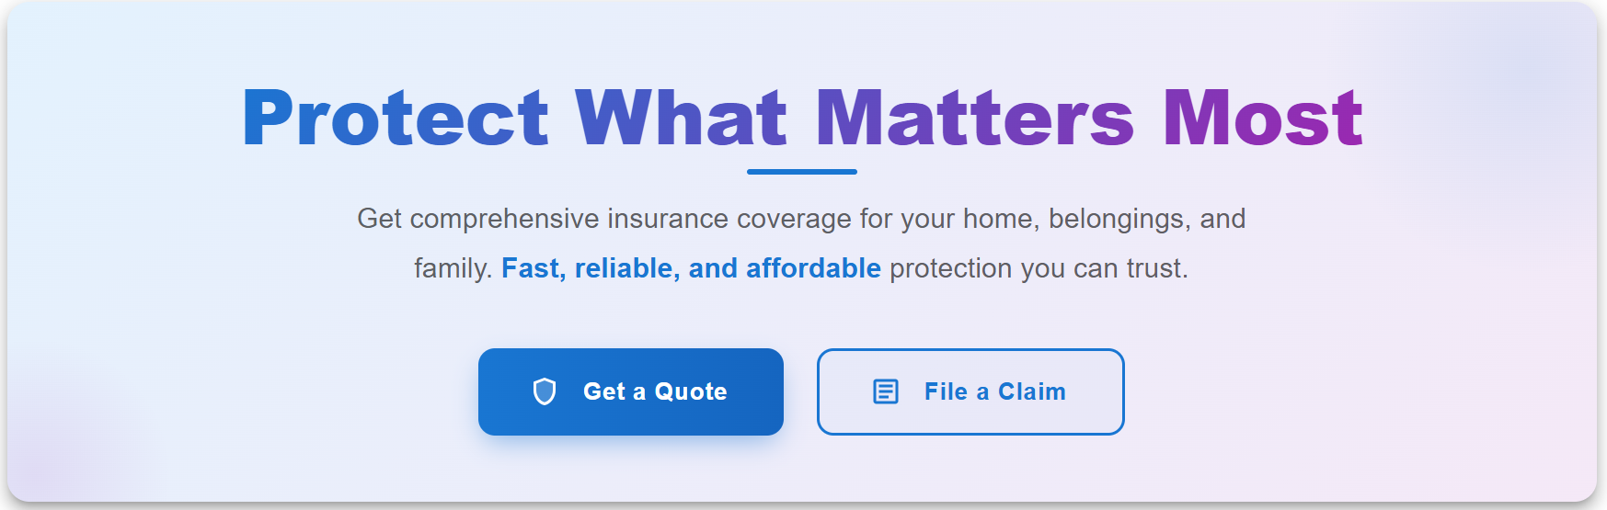
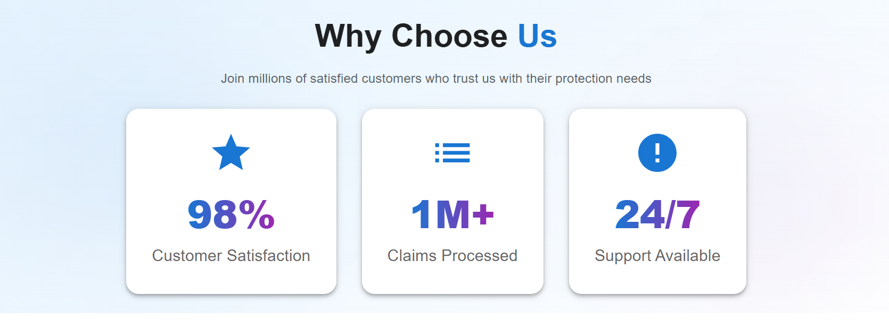

Slide 6
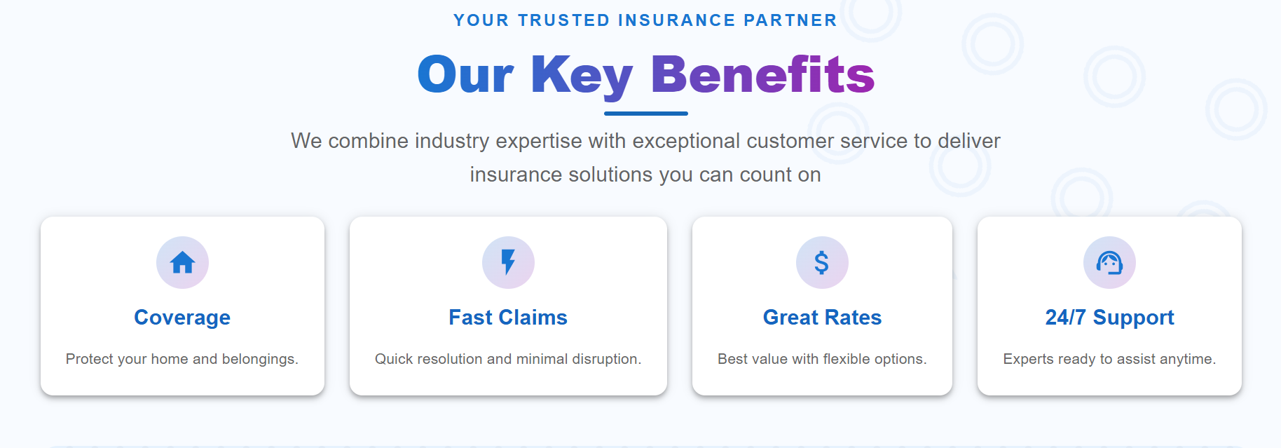
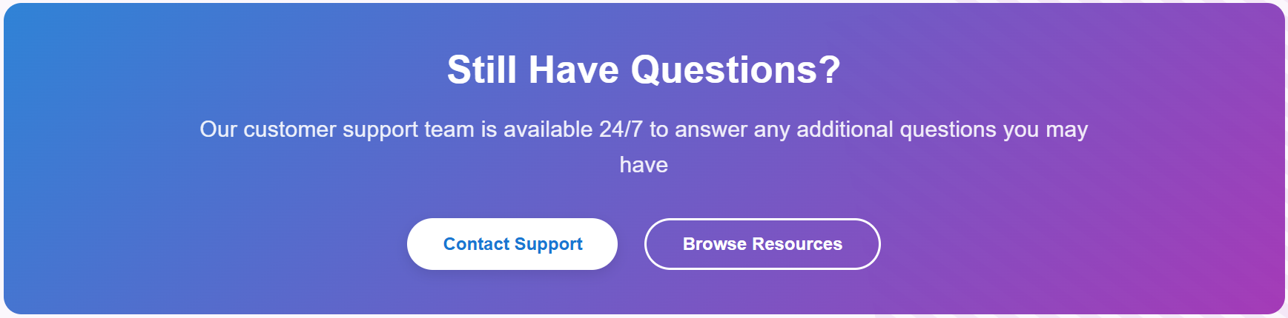

Slide 7
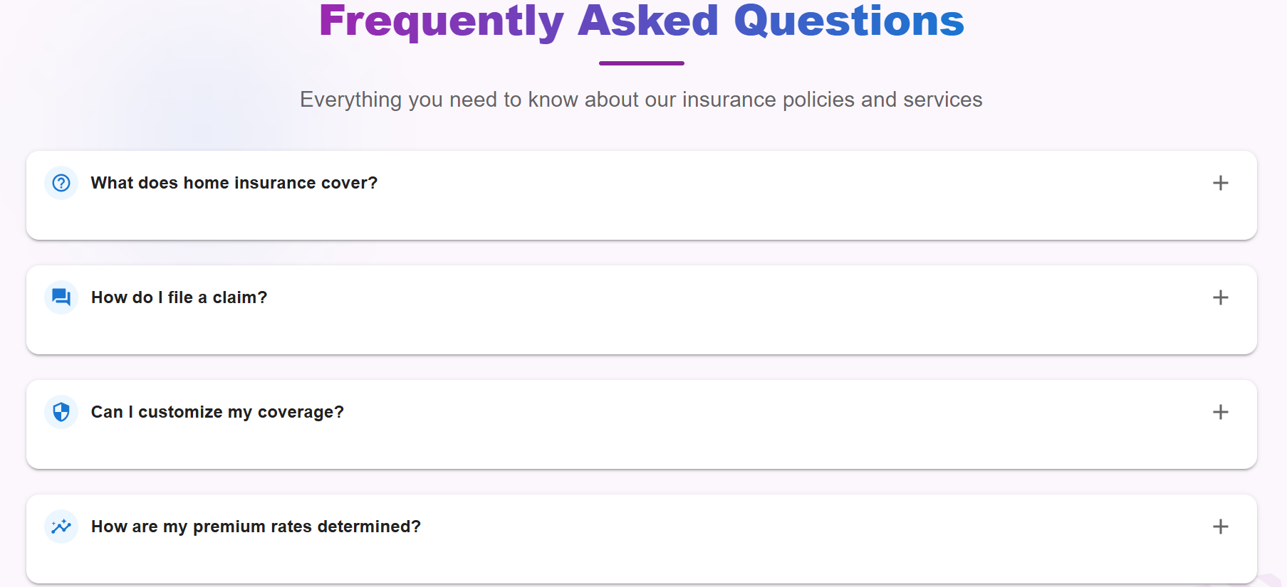
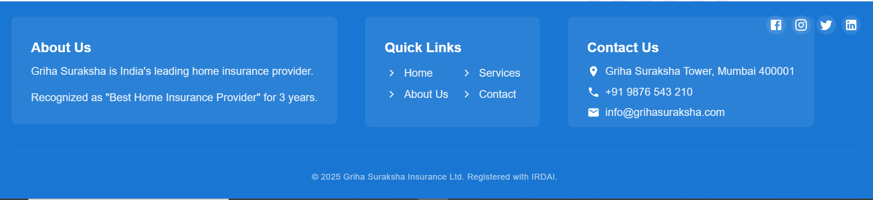

Slide 8
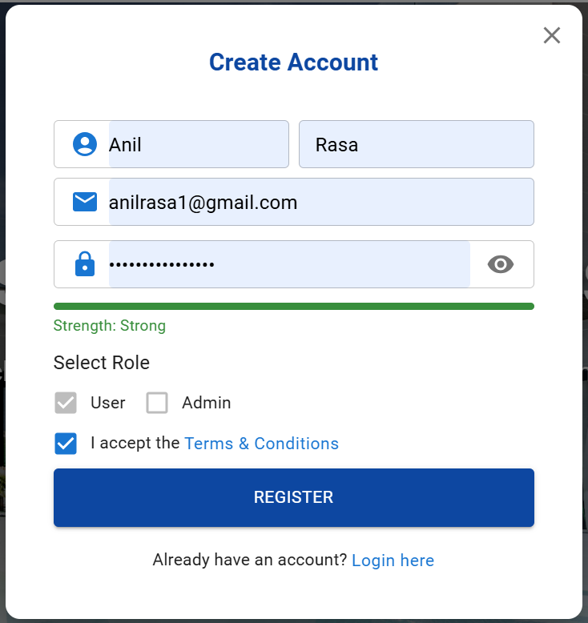
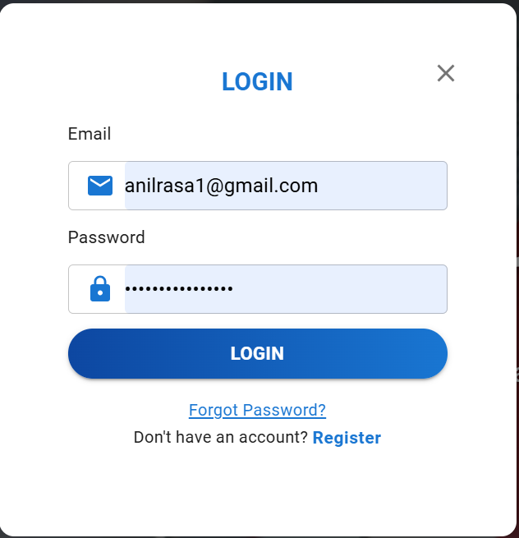
Register and Login page
The user should first navigate to the Home Insurance registration page and provide all the required credentials. After filling in the details, the user can click the Register button, which will trigger a popup message saying Registration Successful.
After registration, the user needs to log in to access more features.

Slide 9
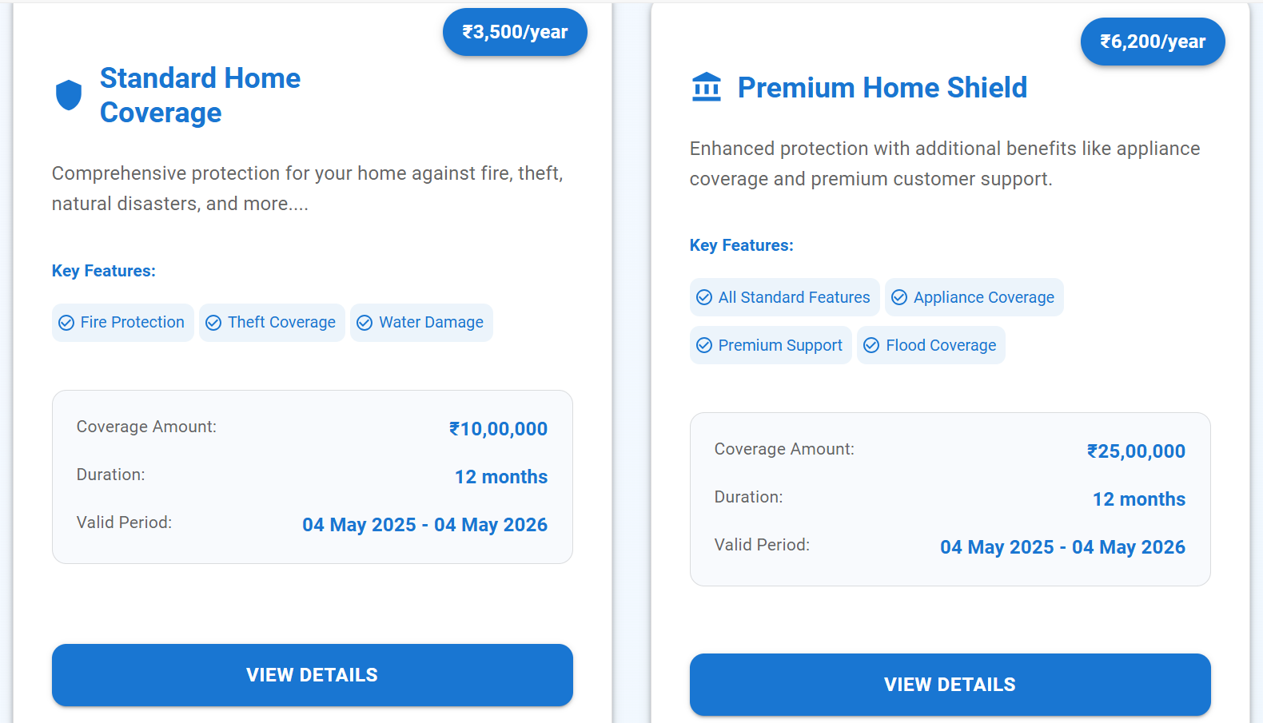
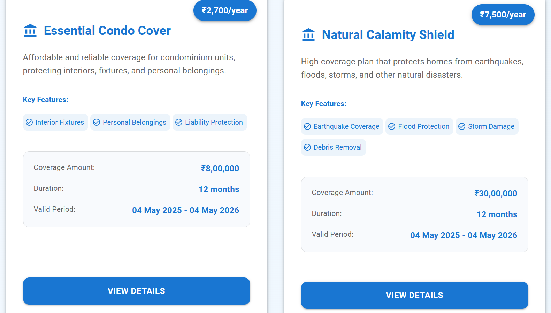
AFTER LOGGING IN, THE USER WILL BE REDIRECTED TO THE POLICIES PAGE. THERE ARE FOUR DIFFERENT POLICIES ARE AVAILABLE, AND THE USER CAN SELECT THE ONE THAT BEST SUITS THEIR NEEDS.

Slide 10
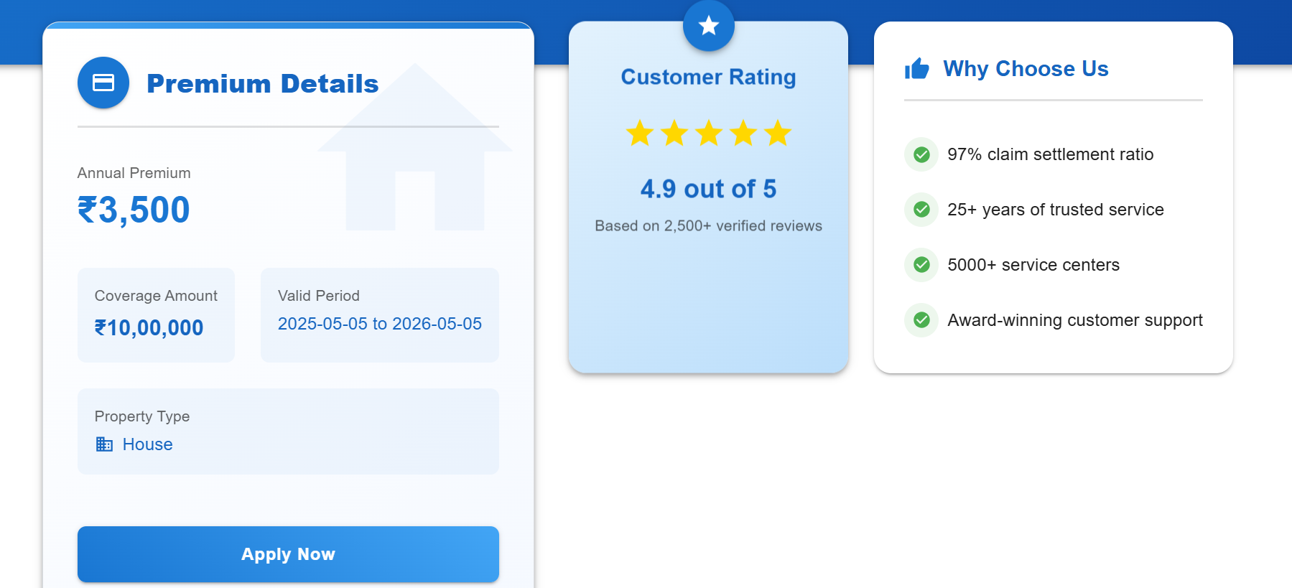
PREMIUM DETAILS
WHEN THE USER CLICKS ON APPLY NOW, THEY WILL BE REDIRECTED TO THE ADD PROPERTY PAGE, WHERE THEY CAN ADD THE PROPERTY DETAILS.

Slide 11
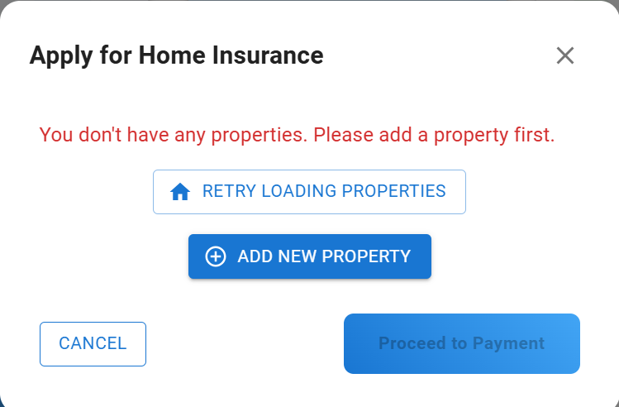
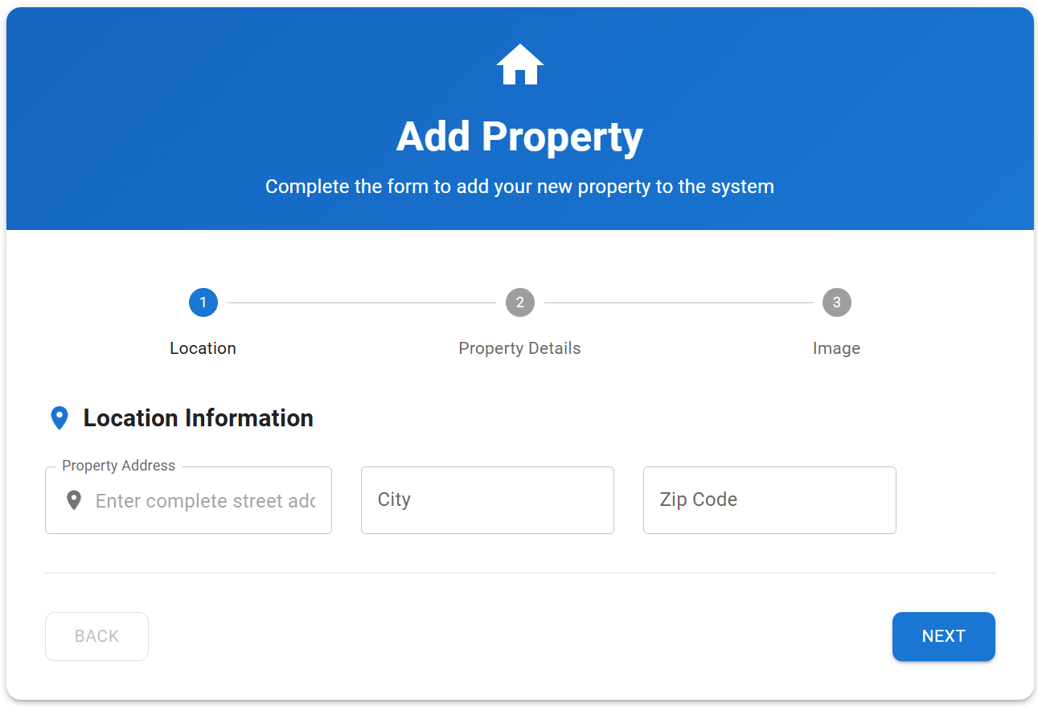
ADD PROPERTY
IF THE USER IS NEW, THEY MUST ADD THE PROPERTY DETAILS BEFORE PROCEEDING TO THE PAYMENT PAGE. OTHERWISE, THEY CAN DIRECTLY NAVIGATE TO THE PAYMENT PAGE AND COMPLETE THEIR PAYMENT.

Slide 12
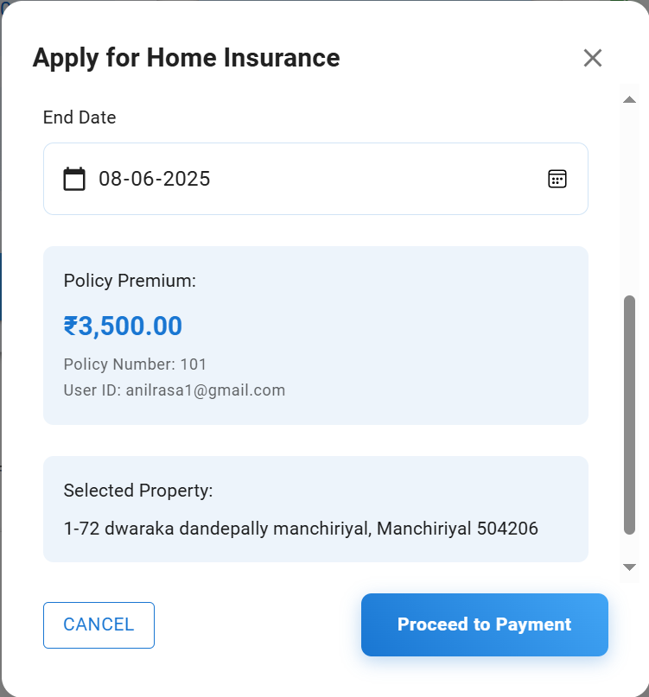
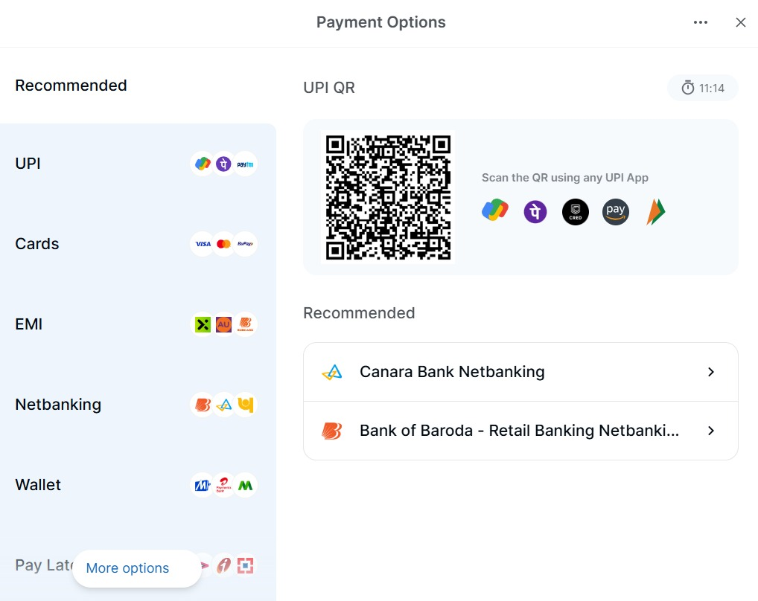
PAYMENT
WHEN THE USER CLICKS ON THE PAYMENT BUTTON, DIFFERENT PAYMENT OPTIONS WILL BE DISPLAYED, AND THE USER CAN MAKE THE PAYMENT DIRECTLY.

Slide 13
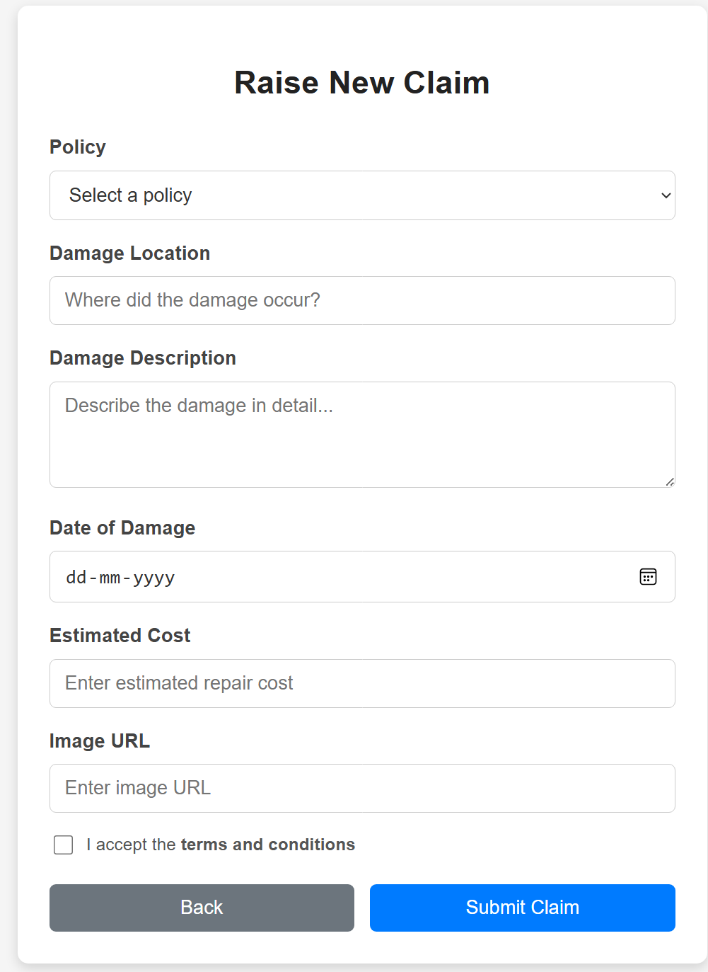
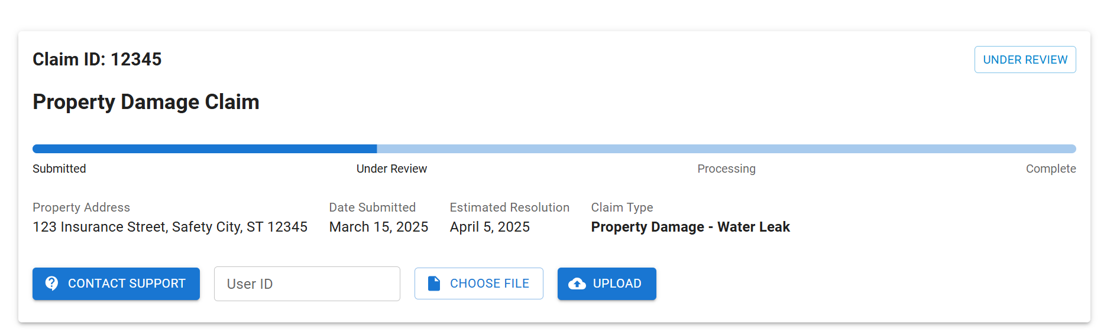
Raise and ClaIm TRACK
If a user wants to file a claim, they need to submit a claim application and can also track its status.

Slide 14
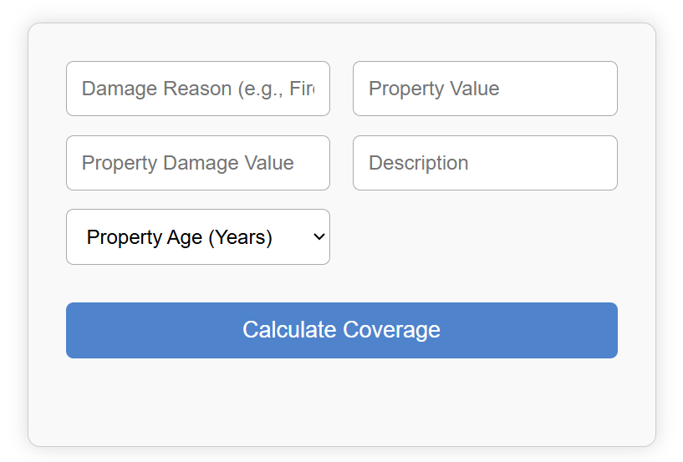
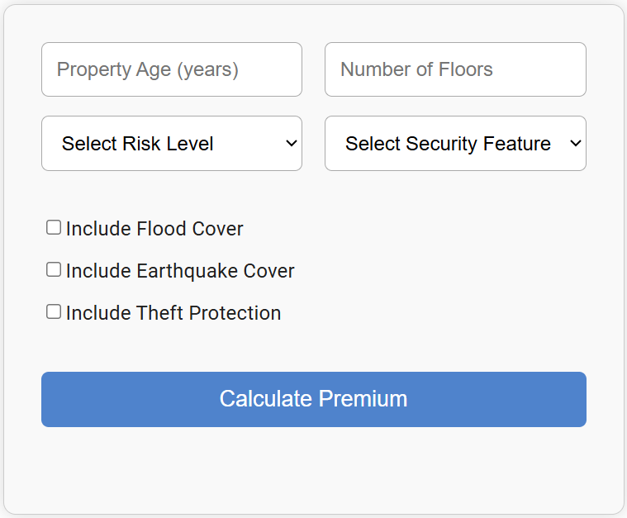
Premium And Coverage
The premium amount is calculated based on the estimated property value and the selected coverage amount, ensuring accurate and fair pricing for the insurance policy.

Slide 15
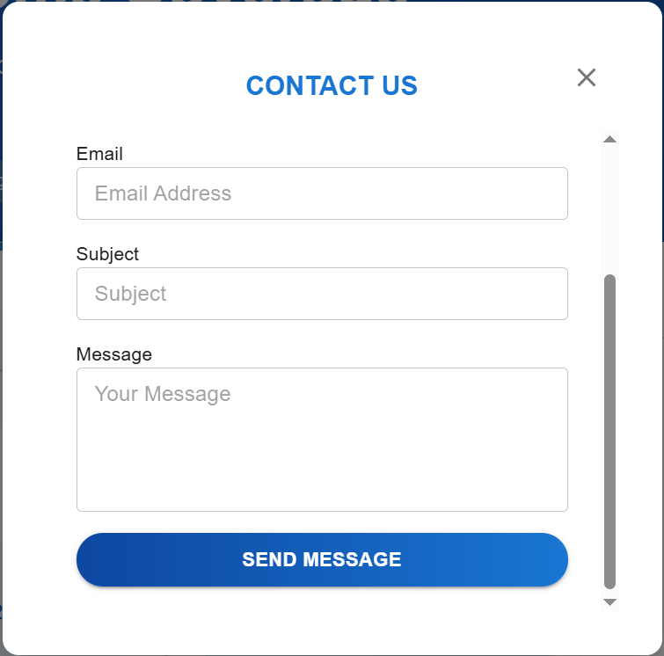
USER support
Users can inquire about policy coverage, premium calculations, renewal schedules, and the claims process
For assistance with login issues, document uploads, or payment processing, users can access immediate support.

Slide 16
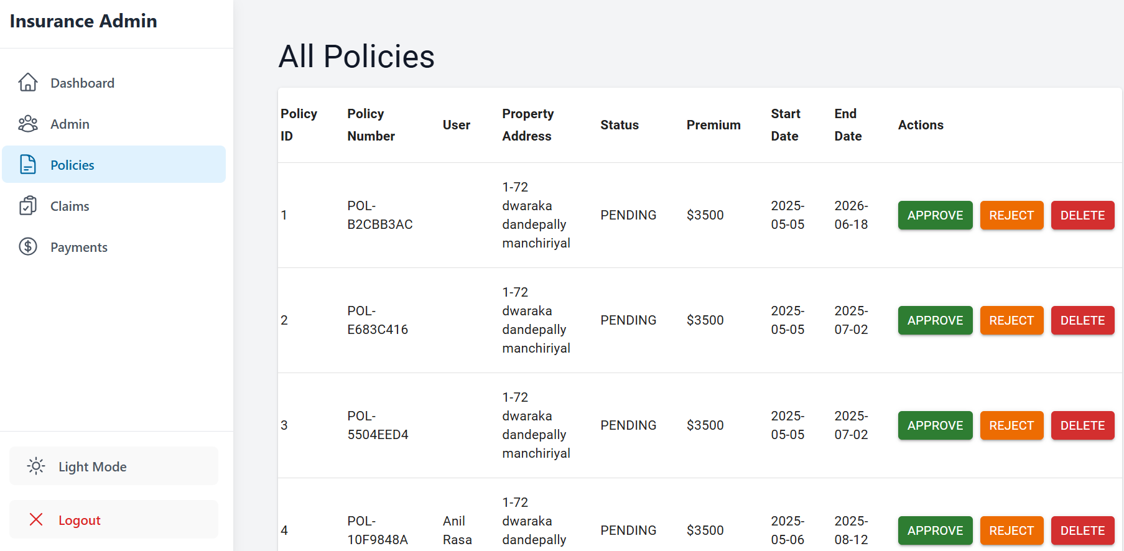
All policies-Admin
AFTER A USER SUCCESSFULLY TAKES OUT A POLICY, IT WILL BE VISIBLE TO THE ADMIN, WHO HAS THE ABILITY TO APPROVE, REJECT, OR DELETE THE POLICY.

Slide 17
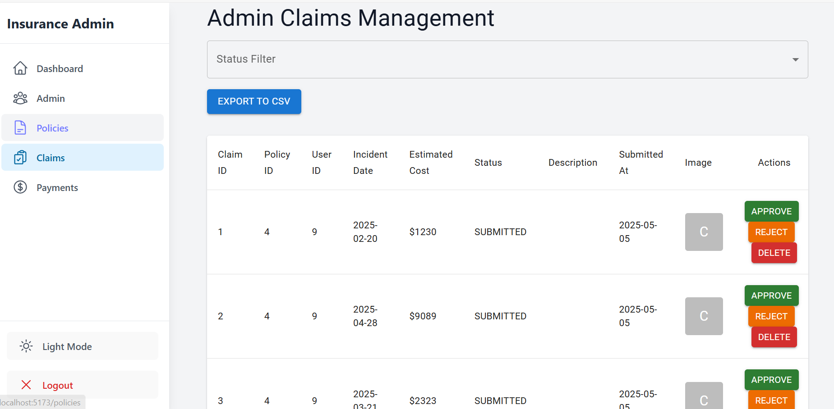
Admin claim management
WHEN A USER RAISES A CLAIM, IT BECOMES VISIBLE TO THE ADMIN. THE ADMIN CAN THEN REVIEW THE CLAIM AND TAKE APPROPRIATE ACTION—EITHER APPROVE, REJECT, OR DELETE IT.

Slide 18
Technologies
Frontend(React)
React (vite) -Component-based UI
Axios – HTTP client for API calls
Material-UI(MUI)- UI component
React Hook Form – Form handling and validation
React Router – routing
Toastify – used in notifications
Backend (Spring boot)
Spring Boot – java –based backend frame work
Spring data jpa – ORM for Database operations( it can be connect database)
Spring Security and JWT Token – Authentication and authorization
Data Base and other tools
Postgres SQL – for relational data base
Postman –API testing

Slide 19
Ci/cd

Slide 20
FUTURE SCOPE
NOTIFICATION SERVICE
WEBSOCKETS (SPRING BOOT + REACT)
USE SPRING’S @ENABLEWEBSOCKET + @SENDTO +STOMP MESSAGING.
REACT CAN USE @STOMP/STOMPJS OR SOCKJS-CLIENT TO SUBSCRIBE AND DISPLAY MESSAGES.
RENEWAL & QUOTATION
GOOGLE MAPS SERVICE
DDOS ATTACK PROTECTION
IMPLEMENTING SUPER ADMIN
KYC IMPLEMENTATION & AUTOMATION

Slide 21
conclusion
THE HOME INSURANCE MANAGEMENT SYSTEM SIMPLIFIES AND MODERNIZES POLICY MANAGEMENT, CLAIMS PROCESSING, AND RISK ASSESSMENT. BY AUTOMATING KEY PROCESSES, PROVIDING REAL-TIME TRANSPARENCY, AND LEVERAGING DATA-DRIVEN INSIGHTS, OUR SOLUTION ENHANCES EFFICIENCY FOR INSURERS AND IMPROVES CONVENIENCE FOR POLICYHOLDERS. WITH STREAMLINED WORKFLOWS AND ACCURATE ANALYTICS, THIS SYSTEM PAVES THE WAY FOR A SMARTER, MORE RELIABLE APPROACH TO HOME INSURANCE MANAGEMENT.

Slide 22
Team Member Contributions
Abhishek KUMAR: Frontend: Admin, Payment, Track Claims
Backend: Payment, Track Claims, Document Management
Others: DevOps, Cloud
Albin Benny:
Frontend: Register, Forgot Password, Landing Page, Add Property, Policies
Others: Testing, Integration
ANIL RASA:
Frontend: Claims, Forgot Password
Backend: Forgot Password
Others: Testing (Frontend & Backend)
Ancha Navyasri:
Frontend: User Dashboard
Backend: User Dashboard
Others: DevOps
Lokesh batta:
Features: Update Profile, Forgot Password, Razorpay Integration
Others: Documentation (Pdfs, PPT)
PRAVEEN R:
Backend: Login, Register, Reset Password, Email Service, Claims, Policies, Admin
Frontend: Admin
Others: Frontend & Backend Integration
VIKRAM:
UI/UX & Navigation: Login Page, Landing Page, Designing, Routing

Slide 23
Thank you

